Slide 1

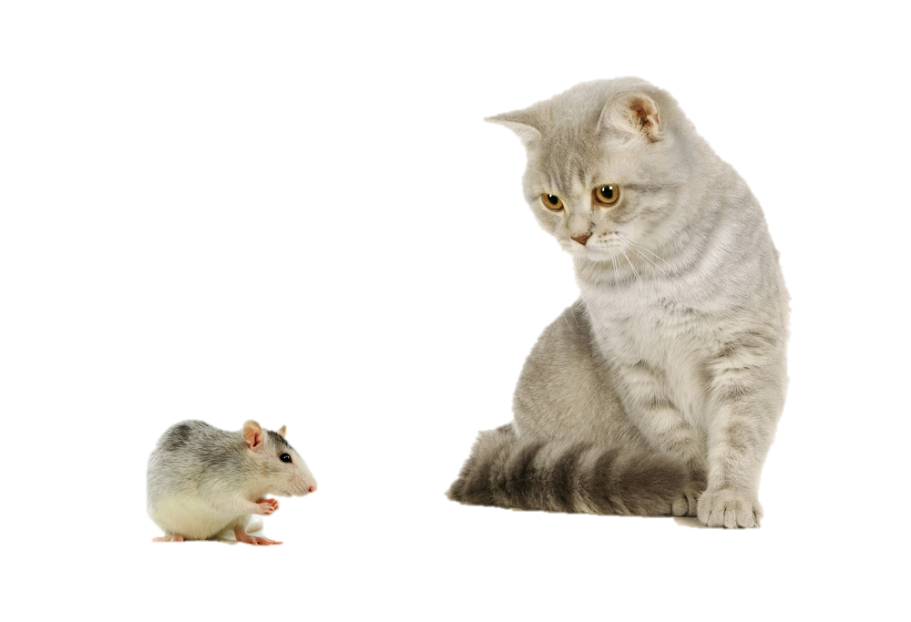
Cat Simulator
INSTRUCTIONS
START

Slide 2
Cat Simulator
Instructions
Chase the mouse with the cat! Help the mouse run away!
Use WASD to move the cat, get close to the mouse to catch it!
Use Arrow keys to move mouse, escape through the hole in the wall!
Use R to reset animals
ESC to quit the program
F1 to display instructions
TITLE SCREEN
START

Slide 3
Cat Won!
EXIT
PLAY AGAIN

Slide 4
Mouse Won!
EXIT
PLAY AGAIN

